Slide 1
Rage, Flower Thrower
Made by Banksy
Followed by people

Slide 2
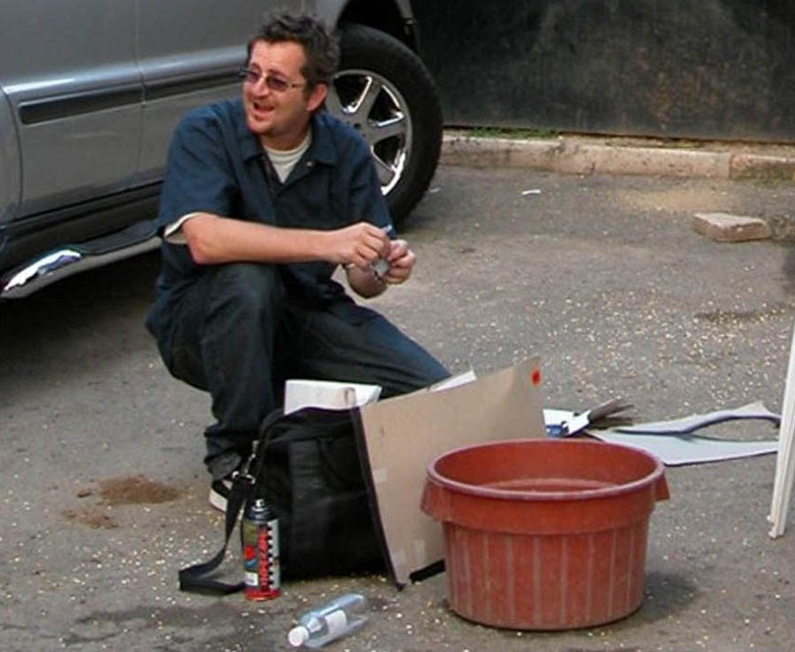
Who is Bansky?
Nobody?
Just a nice guy?
Robert Del Naja?
Nobody knows

Slide 3
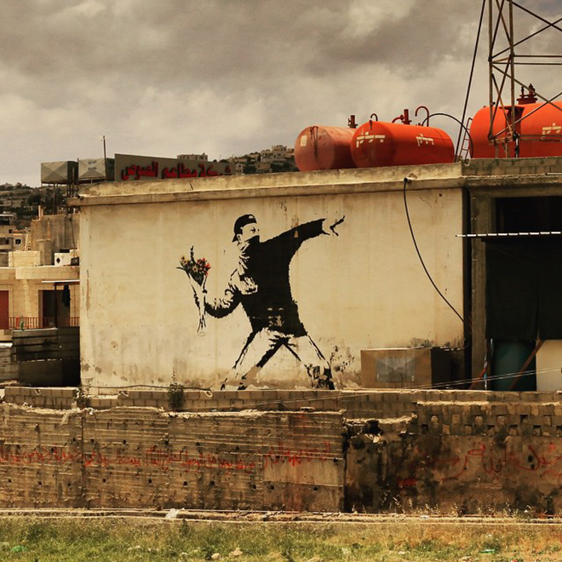
Notes:
Jerusalem, Road to Bethlehem, 2003.
Massacre of the Innocents

Slide 4
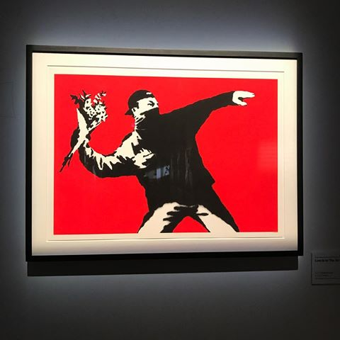
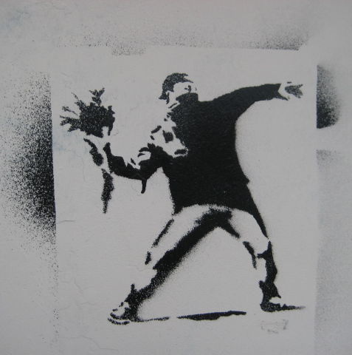
Notes:
1) Wall of Tears
2) Moscow

Slide 5
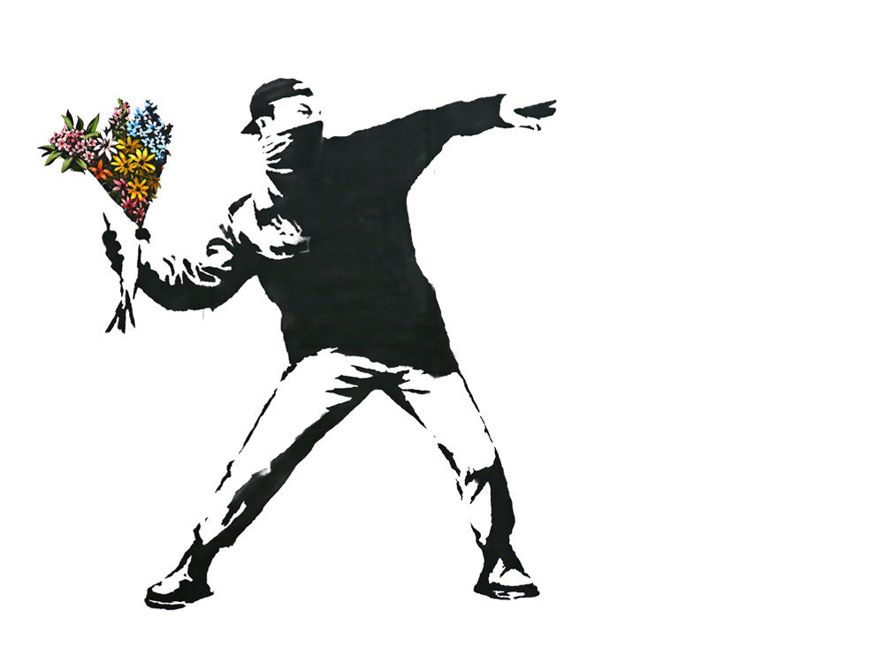

Slide 6
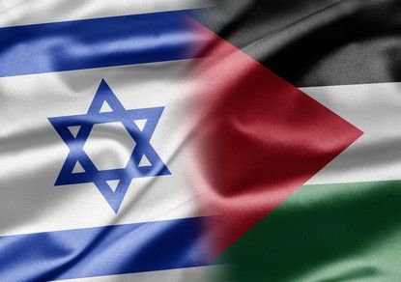
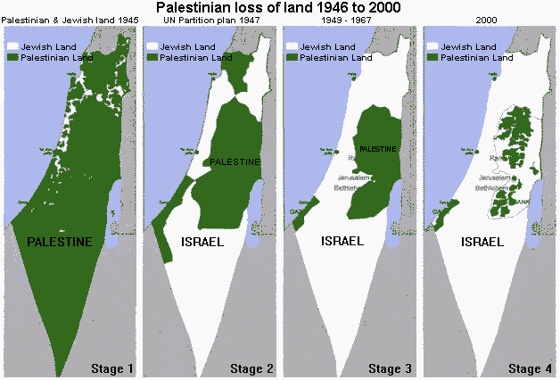
What for?

Slide 7
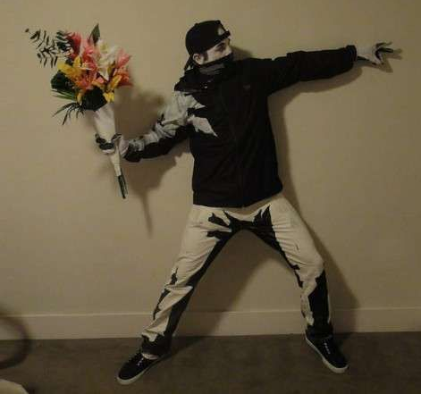
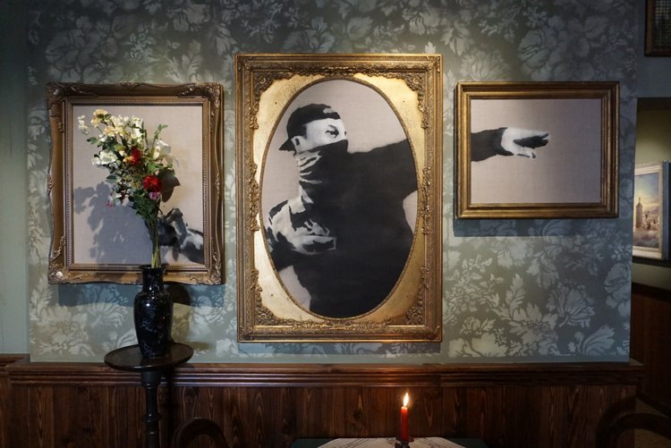
Art or just a vandalism?
Vandalism is meaningless and cruel destruction …
Art is creative activity …
Definitely Art

Slide 8
What for me?
Uncovered reality
Hopeful future

Slide 9
Thanks for watching

